Slide 1
Crossing the Roads
Safely

Slide 2
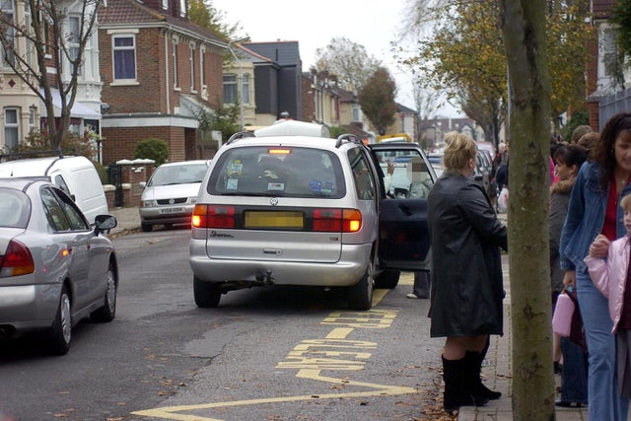
Why are the roads so busy?
There are lots of people travelling:
Some to work
Some to school
Some to other places

Slide 3
What Does This Mean for You?
Whether you are:
Walking to school
Out with your friends
Walking with your family during school holidays
You need to do things to help keep you safe on the roads
Can you spot something good and something that’s not so good in the picture on the next slide?

Slide 4
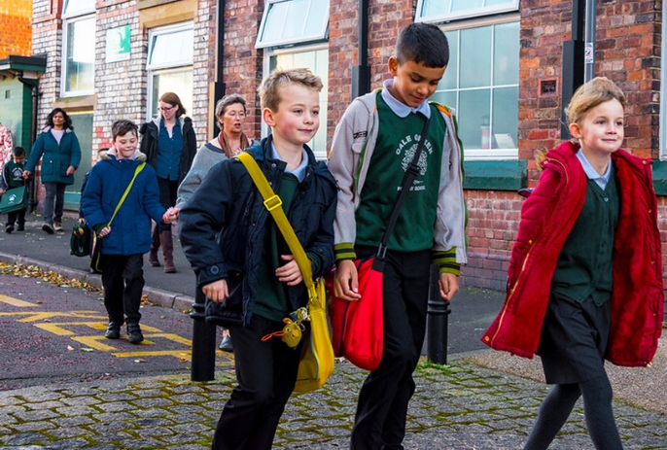
Holding Hands is good
Walking in the road is not good

Slide 5
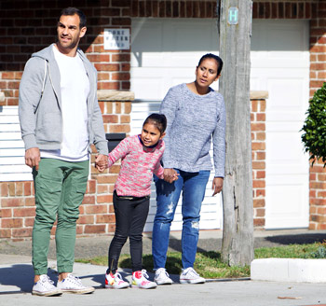
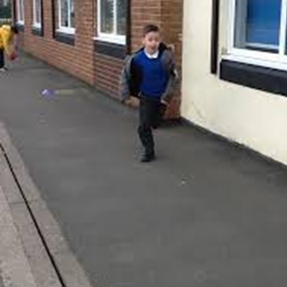
Holding hands helps keep you safe
Always hold hands with a grown up when:
Near roads
Crossing the road
Think….. what might happen if you run ahead?

Slide 6
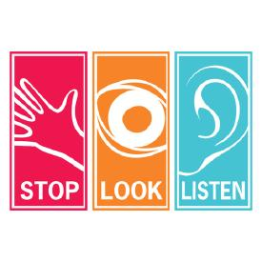
Crossing the Road
Can you remember the 3 words that help us cross the road safely?
It’s something you do with your:
FEET
EYES
EARS

Slide 7
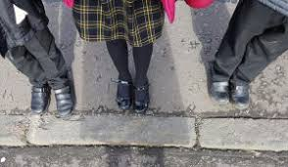
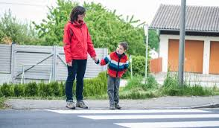
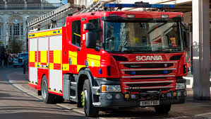
Stop – always stop at the road. Stand on the pavement near the kerb
Look – all around for traffic. Wait for cars to pass. Take your time
Listen – sometimes you can hear traffic before you can see it
When it is safe walk straight across the road. Don’t run!
Keep looking and listening as you cross

Slide 8

Distraction
Have you ever…………?
Watched TV instead of doing your homework
Daydreamed in lessons
Forgot to brush your teeth
You have been distracted!
Now think about what could distract you when crossing the road.
Let’s see if your list is the same as ours….

Slide 9
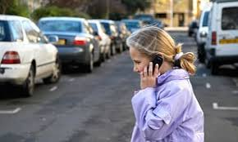
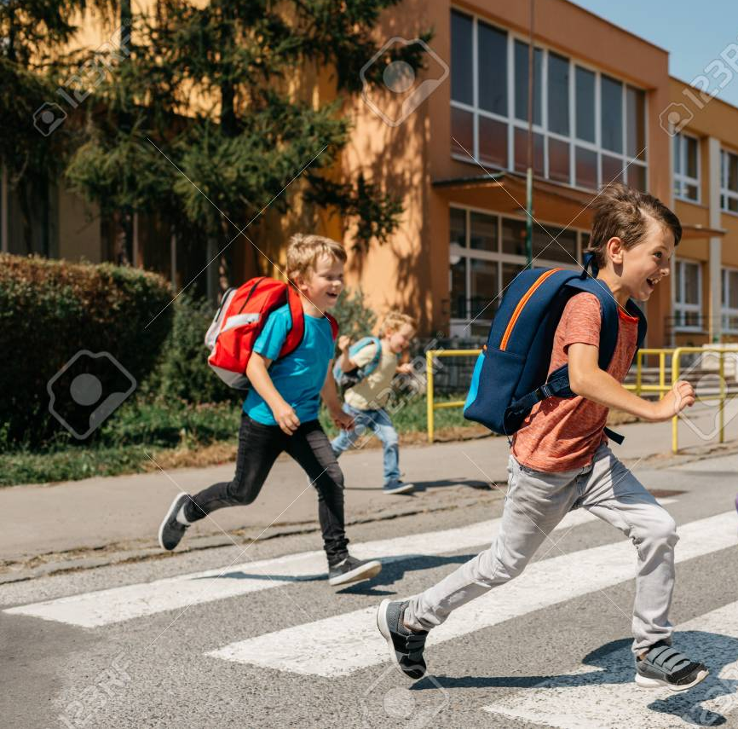
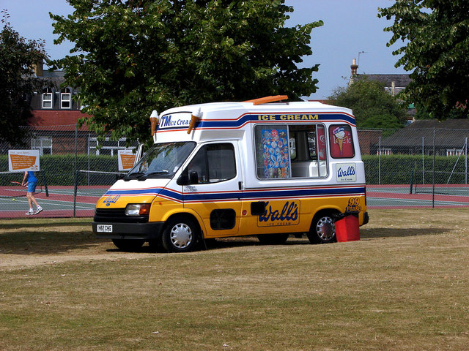
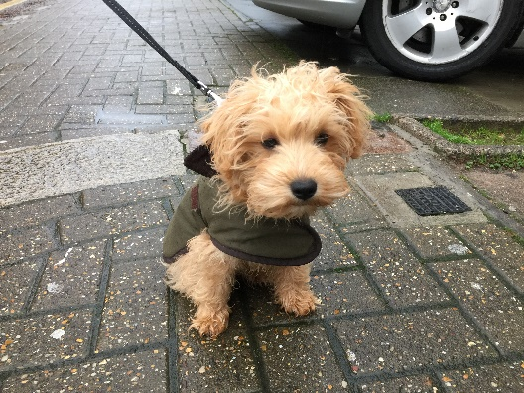
List of Distractions
Talking
Mobile phone
Listening to music
Being with friends
The ice cream van
Daydreaming
That cute dog…

Slide 10
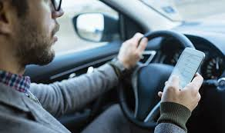
A word about drivers………
Sometimes they get distracted too?
Can you think what might distract a driver?
The phone
Music or the radio
Other passengers
In a hurry

Slide 11
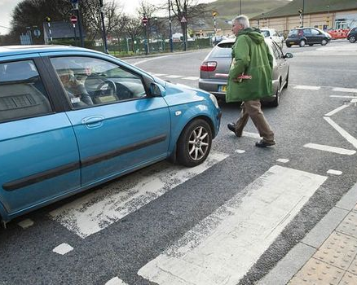
A word about drivers………
Sometimes drivers go too fast
Sometimes they don’t stop when they are supposed to
Sometimes children distract drivers
So you have got to be extra careful
Remember…..

Slide 12
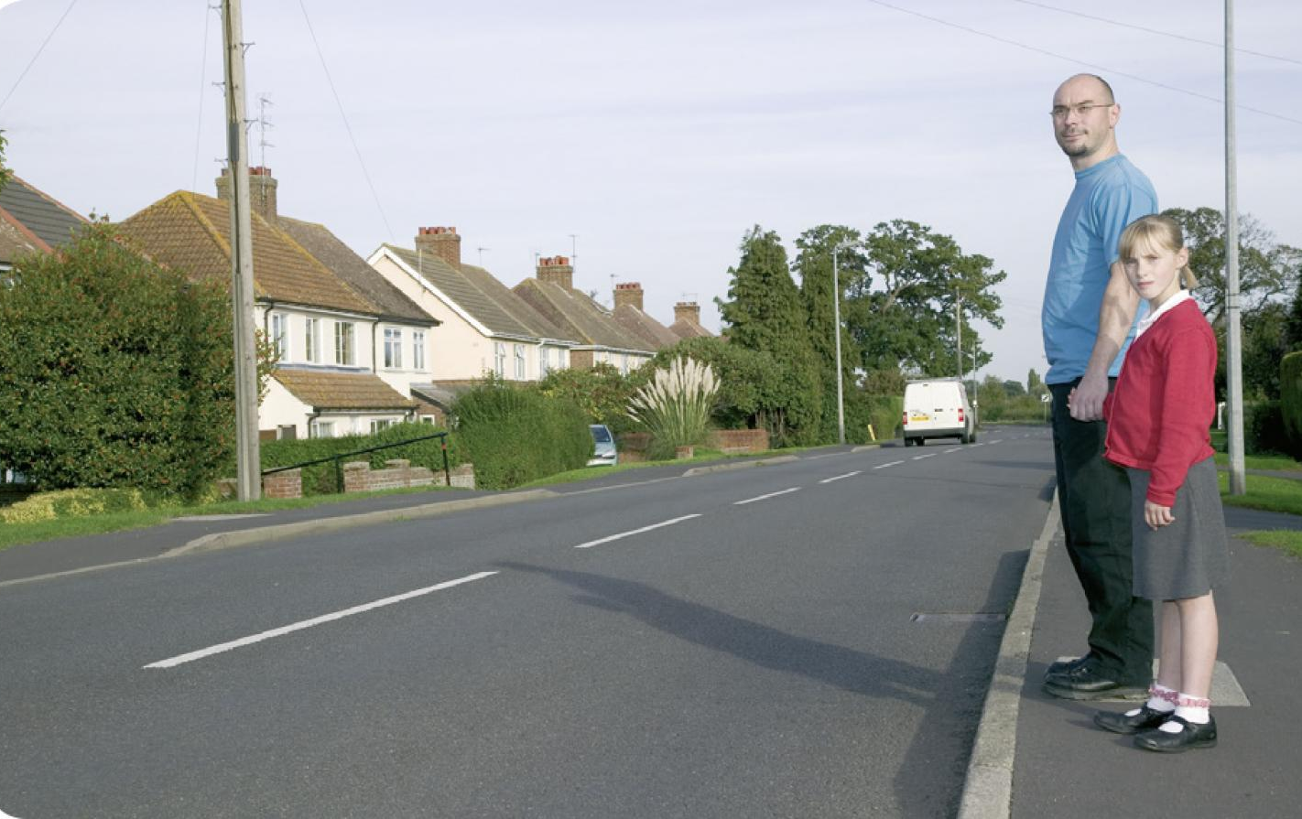
Learning and Checking
You learn about lots of things when you go to school
You also learn to check your work to make sure it’s what you wanted to do.
You’ll do this many times for the rest of your life
Crossing the roads is no different. If you stop checking, you are more likely to make mistakes

Slide 13
Crossing the Roads Safely
Are you going to?

