Slide 2
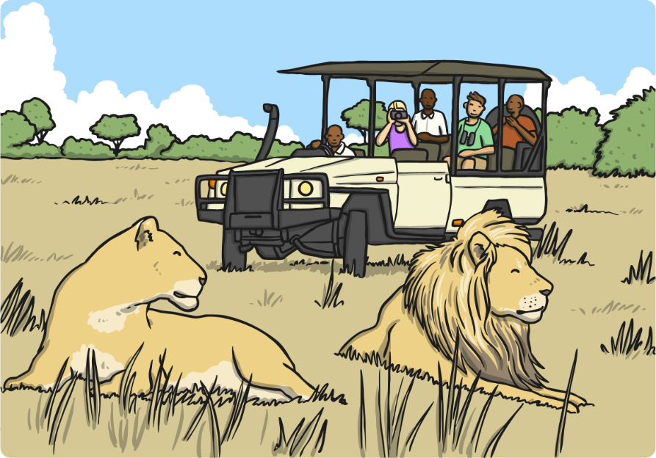
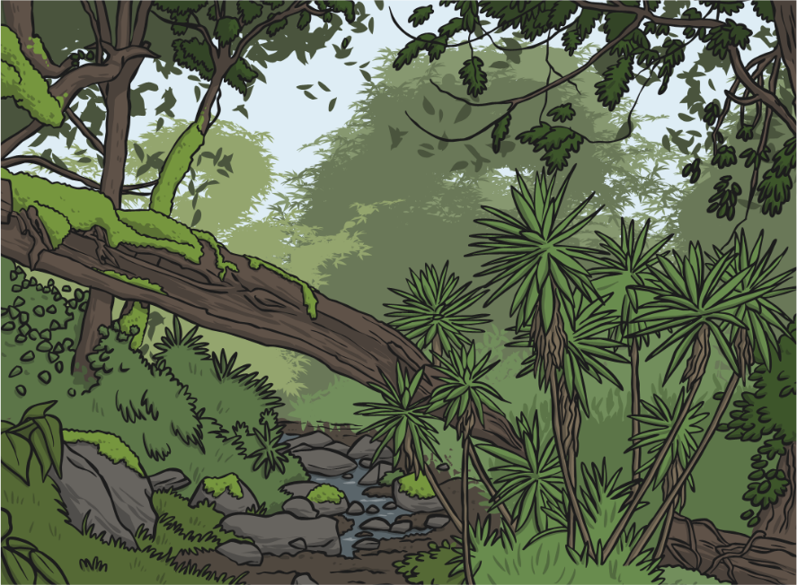
Amazing Africa
Africa is an amazing place. It is made up of a lot of countries that form the second largest continent in the world.
Africa has many different regions including the Sahara desert, grasslands (known as savannas) and highlands.

Slide 3
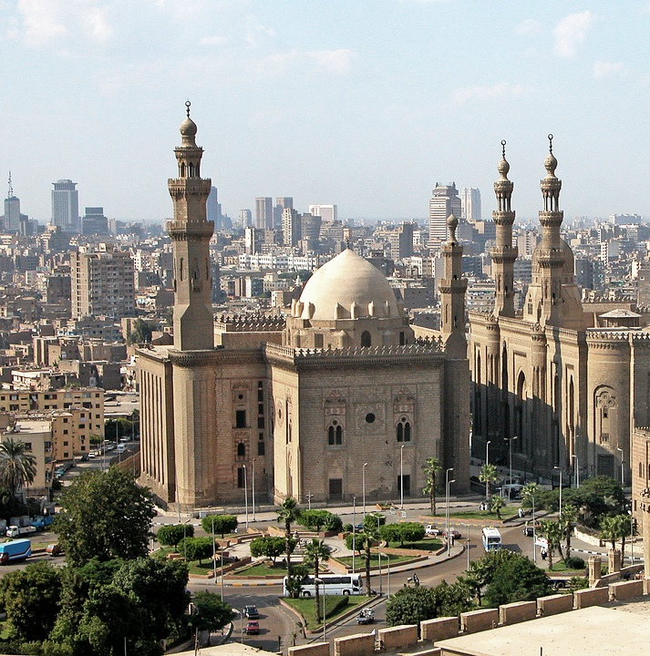
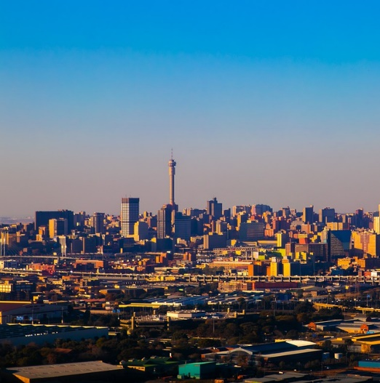
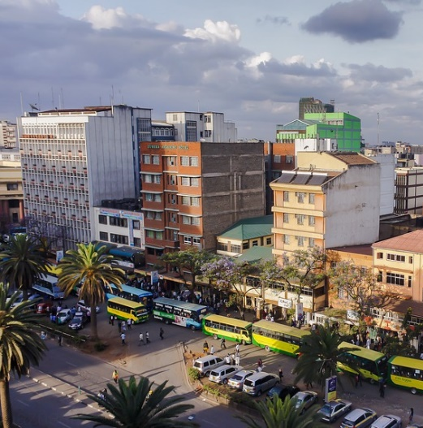
African Cities
There are also many big, bustling cities in African countries.
Cairo is the capital city of Egypt.
Johannesburg is
the biggest city in
South Africa.
Nairobi is the capital city in Kenya.

Slide 4
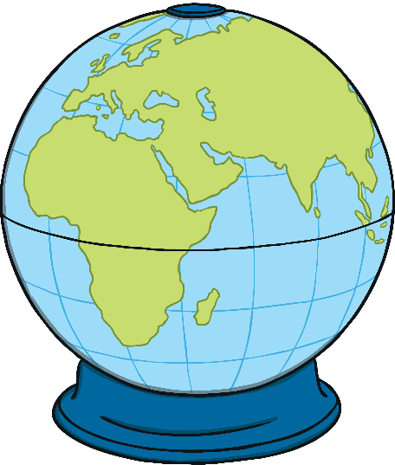
Fascinating Facts
There are 54 countries in Africa.
There are well over 1000 languages spoken in Africa.
South Africa hosted the 2010 World Cup tournament, and was the first African country to do so.
Morocco, in North Africa, is very close to Spain, which is in Europe.
Africa is the hottest continent in the world.
There are glaciers in Africa.

Slide 5
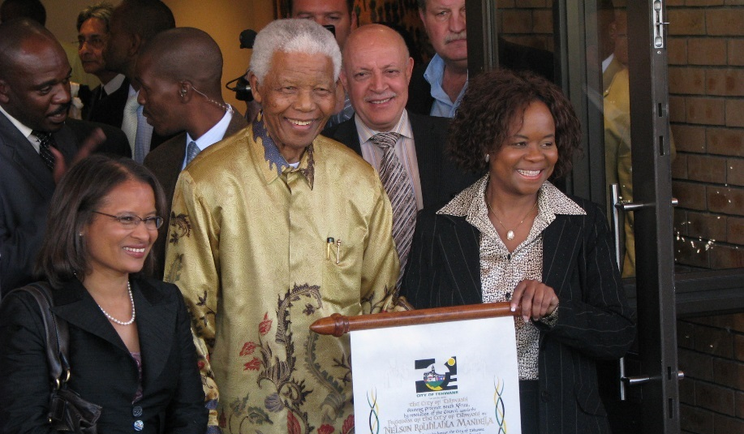
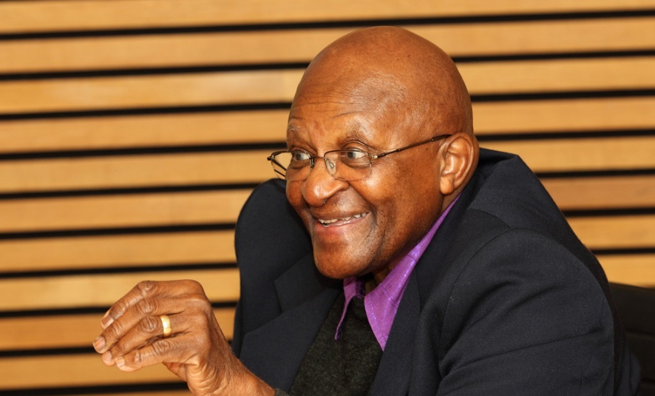
Famous African People
Nelson Mandela
Mandela was a man who stood up against apartheid. This was a time when black people were not treated as well as white people. There was a lot of unfairness. Mandela was kept in prison for 27 years because he tried to make things fairer in Africa for black people.
Archbishop Desmond Tutu
Tutu is an important man who also stood up against apartheid and tried to make life better for black people.
Photo courtesy of South Africa The Good News and Skoll World Forum (@flickr.com) - granted under creative commons licence - attribution

Slide 6
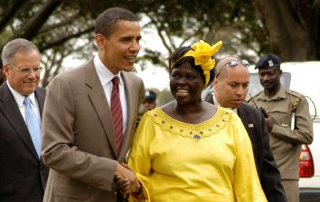
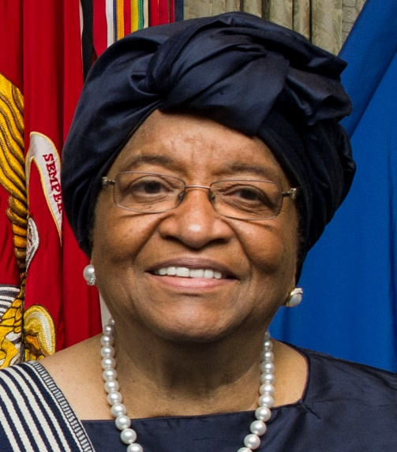
Famous African People
Wangari Maathai
Maathai founded the Green Belt Movement in 1977 which encourages people to plant trees to help the environment. She won the Nobel Peace Prize in 2004 for the work she does for the environment and human rights.
President Ellen Johnson Sirleaf
Sirleaf became Africa’s first female president in 2006. She was the President of Liberia until 2018 and received the Nobel Peace Prize in 2011 for her work in improving women’s rights.
Photo courtesy of Fredrick Onyango and Sean Hurt (@Wikimedia.com) - granted under creative commons licence - attribution

Slide 7
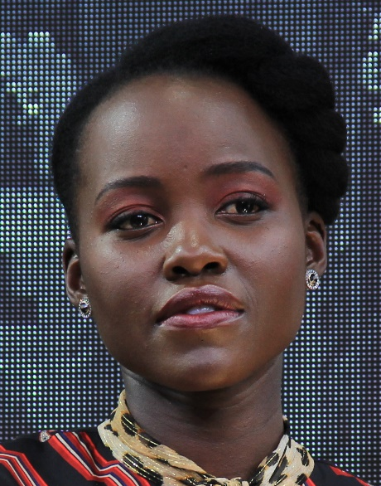
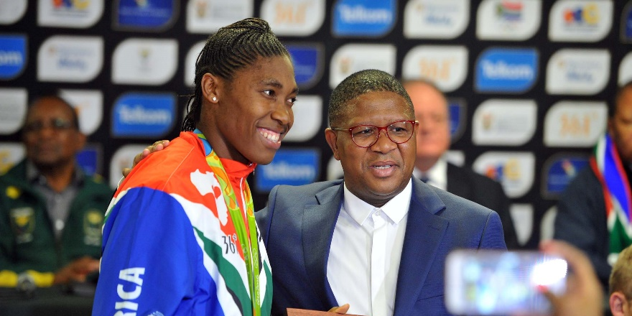
Famous African People
Caster Semenya
Semenya is a South African athlete who won a gold medal at the 2012 and 2016 Olympics. She was chosen to carry the country’s flag during the opening ceremony of the 2012 Summer Olympics. In 2016, she became the first person to win all three of the 400m, 800m and 1500m race titles.
Lupita Nyong’o
Nyong’o is the daughter of a Kenyan politician. She was born in Mexico but raised in Kenya. She has performed in several Hollywood films including 12 Years a Slave and more recently, Black Panther. She is very vocal about women and animal rights and has even written a children’s book called Sulwe.
Photo courtesy of Daniel Benavides from Austin and GovernmentZA (@Wikimedia.com) - granted under creative commons licence - attribution

Slide 8
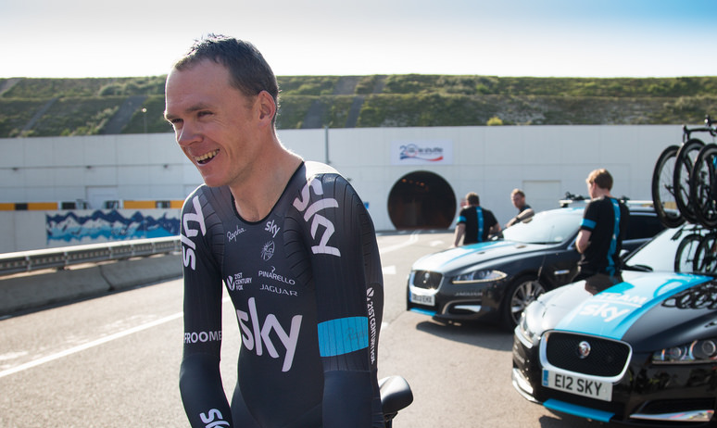
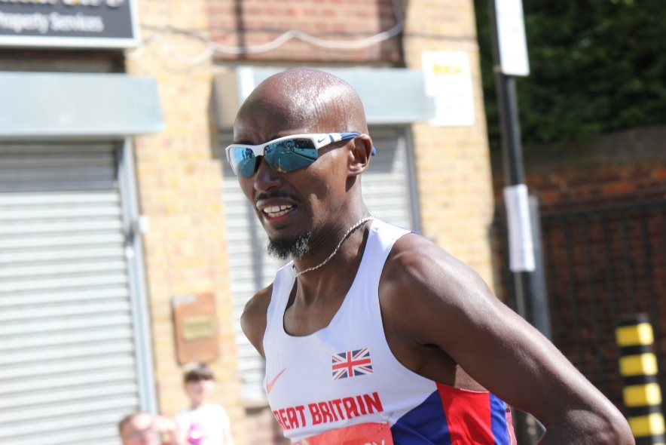
Famous African People
Chris Froome
Froome was born in Nairobi, Kenya, and was brought up in Kenya and South Africa, where he learned to cycle. He competed for Kenya until 2008. In 2008, he decided to ride for Britain because he had a British passport, and his father and grandparents were born in Britain. Froome won the Tour de France in 2013.
Sir Mo Farah
Mo Farah was born in Somalia and moved to England as a child. He became a double Olympic champion after winning gold in 2 events at the 2012 Olympics. Farah was knighted
in 2017 for his services to athletics.
Photo courtesy NH53 and jaguarmena (@flickr.com) - granted under creative commons licence - attribution

Slide 9
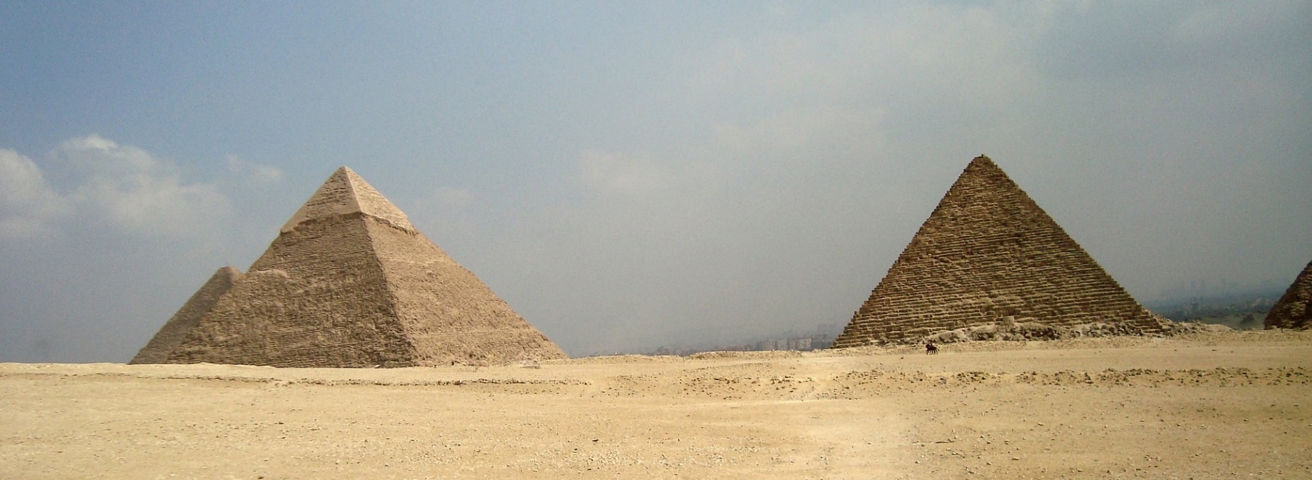
Landmarks
There are many magnificent landmarks in Africa.
The Egyptian pyramids
These are in Egypt and were built over 4000 years ago.
The most famous of these pyramids are found in Giza, near Cairo.
They were built as tombs for the pharaohs.

Slide 10
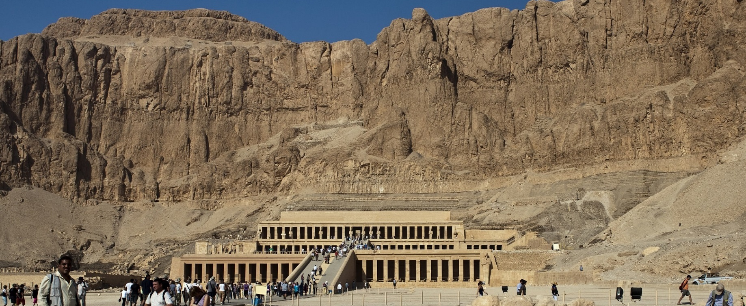
Landmarks
The Valley of the Kings
This landmark is also in Egypt and was another place where kings and pharaohs were buried. The tomb of King Tutankhamun was discovered here in 1922 by Howard Carter.

Slide 11
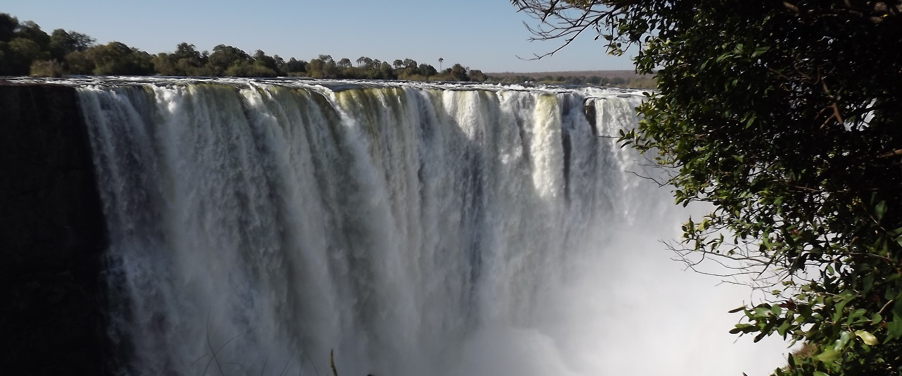
Landmarks
Victoria Falls
These amazing waterfalls are found between 2 countries: Zambia and Zimbabwe. Although they are not the highest or widest waterfalls in the world, they are considered some of the most impressive.

Slide 12
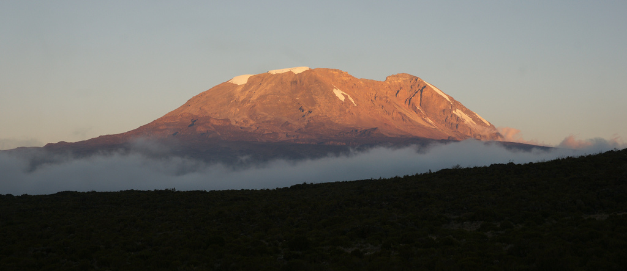
Landmarks
Mount Kilimanjaro
This mountain is in Tanzania. It is the highest mountain in Africa and stands at 5895 metres above sea level. You can see amazing glaciers all around. Many people have enjoyed climbing it.
Photo courtesy mitchpa1984 (@flickr.com) - granted under creative commons licence - attribution

Slide 13
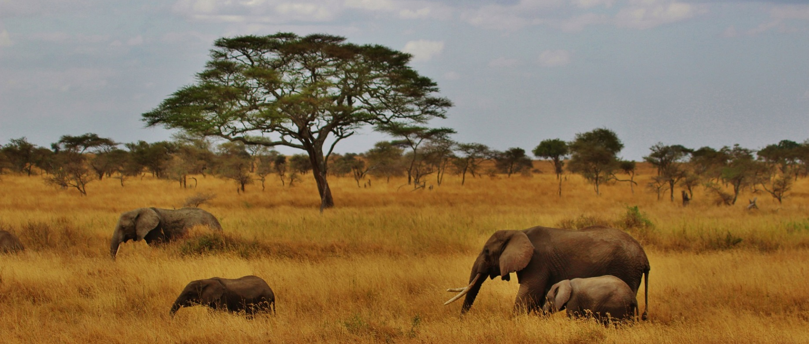
Landmarks
Serengeti National Park, Tanzania
350,000 people visit this beautiful park each year. It covers a huge area of nearly 15,000 km² and is home to millions of animals, including lions, zebras, elephants, and giraffes.

Slide 14
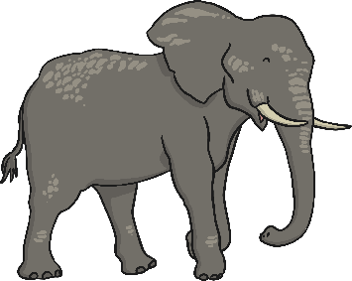
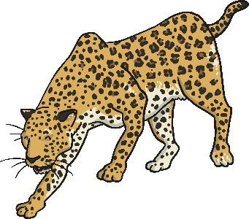
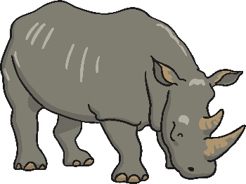
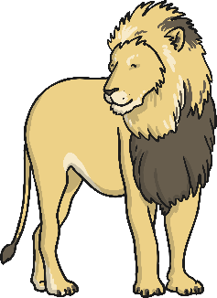
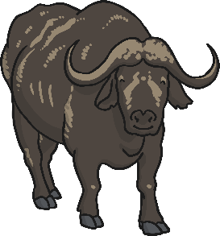
Africa’s Animals
Africa is well known for its wonderful animals. It is one of the few places you can see them in their natural habitat.
People often go to Africa to see the Big 5:
elephant
leopard
rhino
buffalo
lion

Slide 15
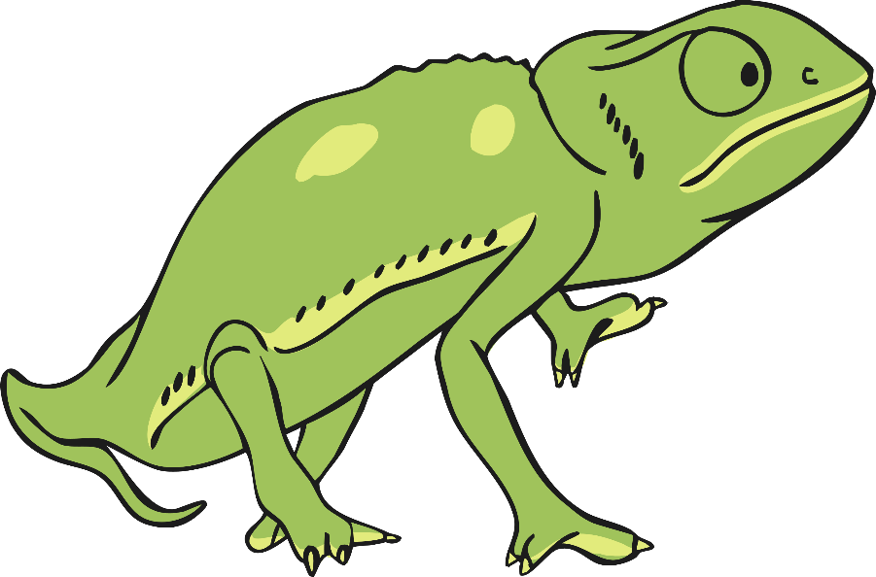
Animal Facts
There are over 2600 different types of bird that live in Africa.
4 out of 5 of the fastest animals in the world can be found in Africa:
The cheetah, which can reach speeds of 70mph.
The wildebeest, Thomson’s gazelle and lion, all of which can reach
speeds of 50 mph.
There are penguins living in a colony in South Africa.
Africa is also home to gorillas, Nile crocodiles
and the world’s largest chameleons.

Slide 16
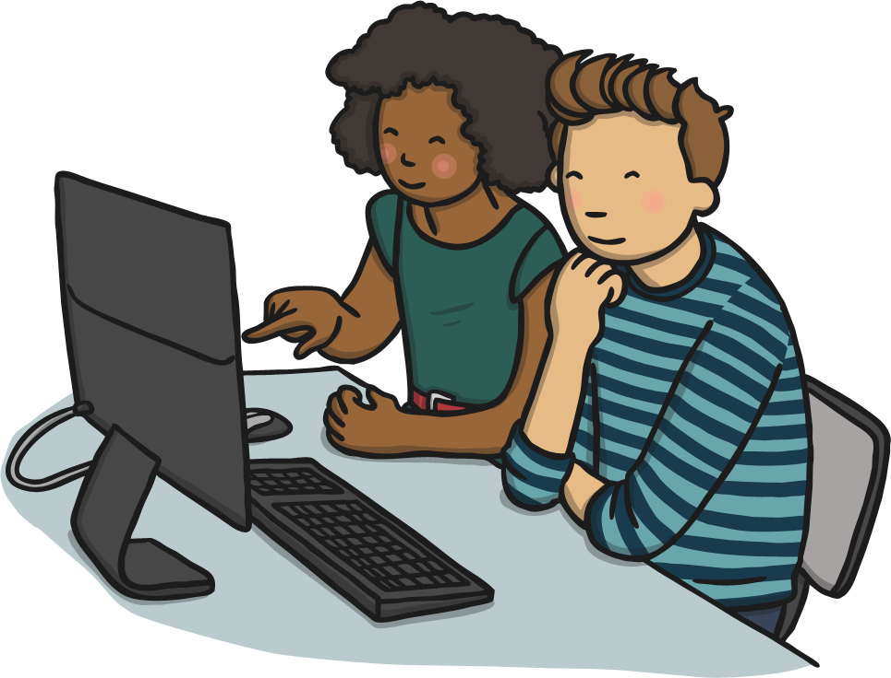
Find Out More!
There is a lot more to find out about Africa.
Why not try to find out more in a non-fiction book or on the Internet?

